Slide 1
Skills intelligence and skills strategy for the microelectronics sector
Presentation of key results
Léo Saint-Martin, Associate Consultant

Slide 2
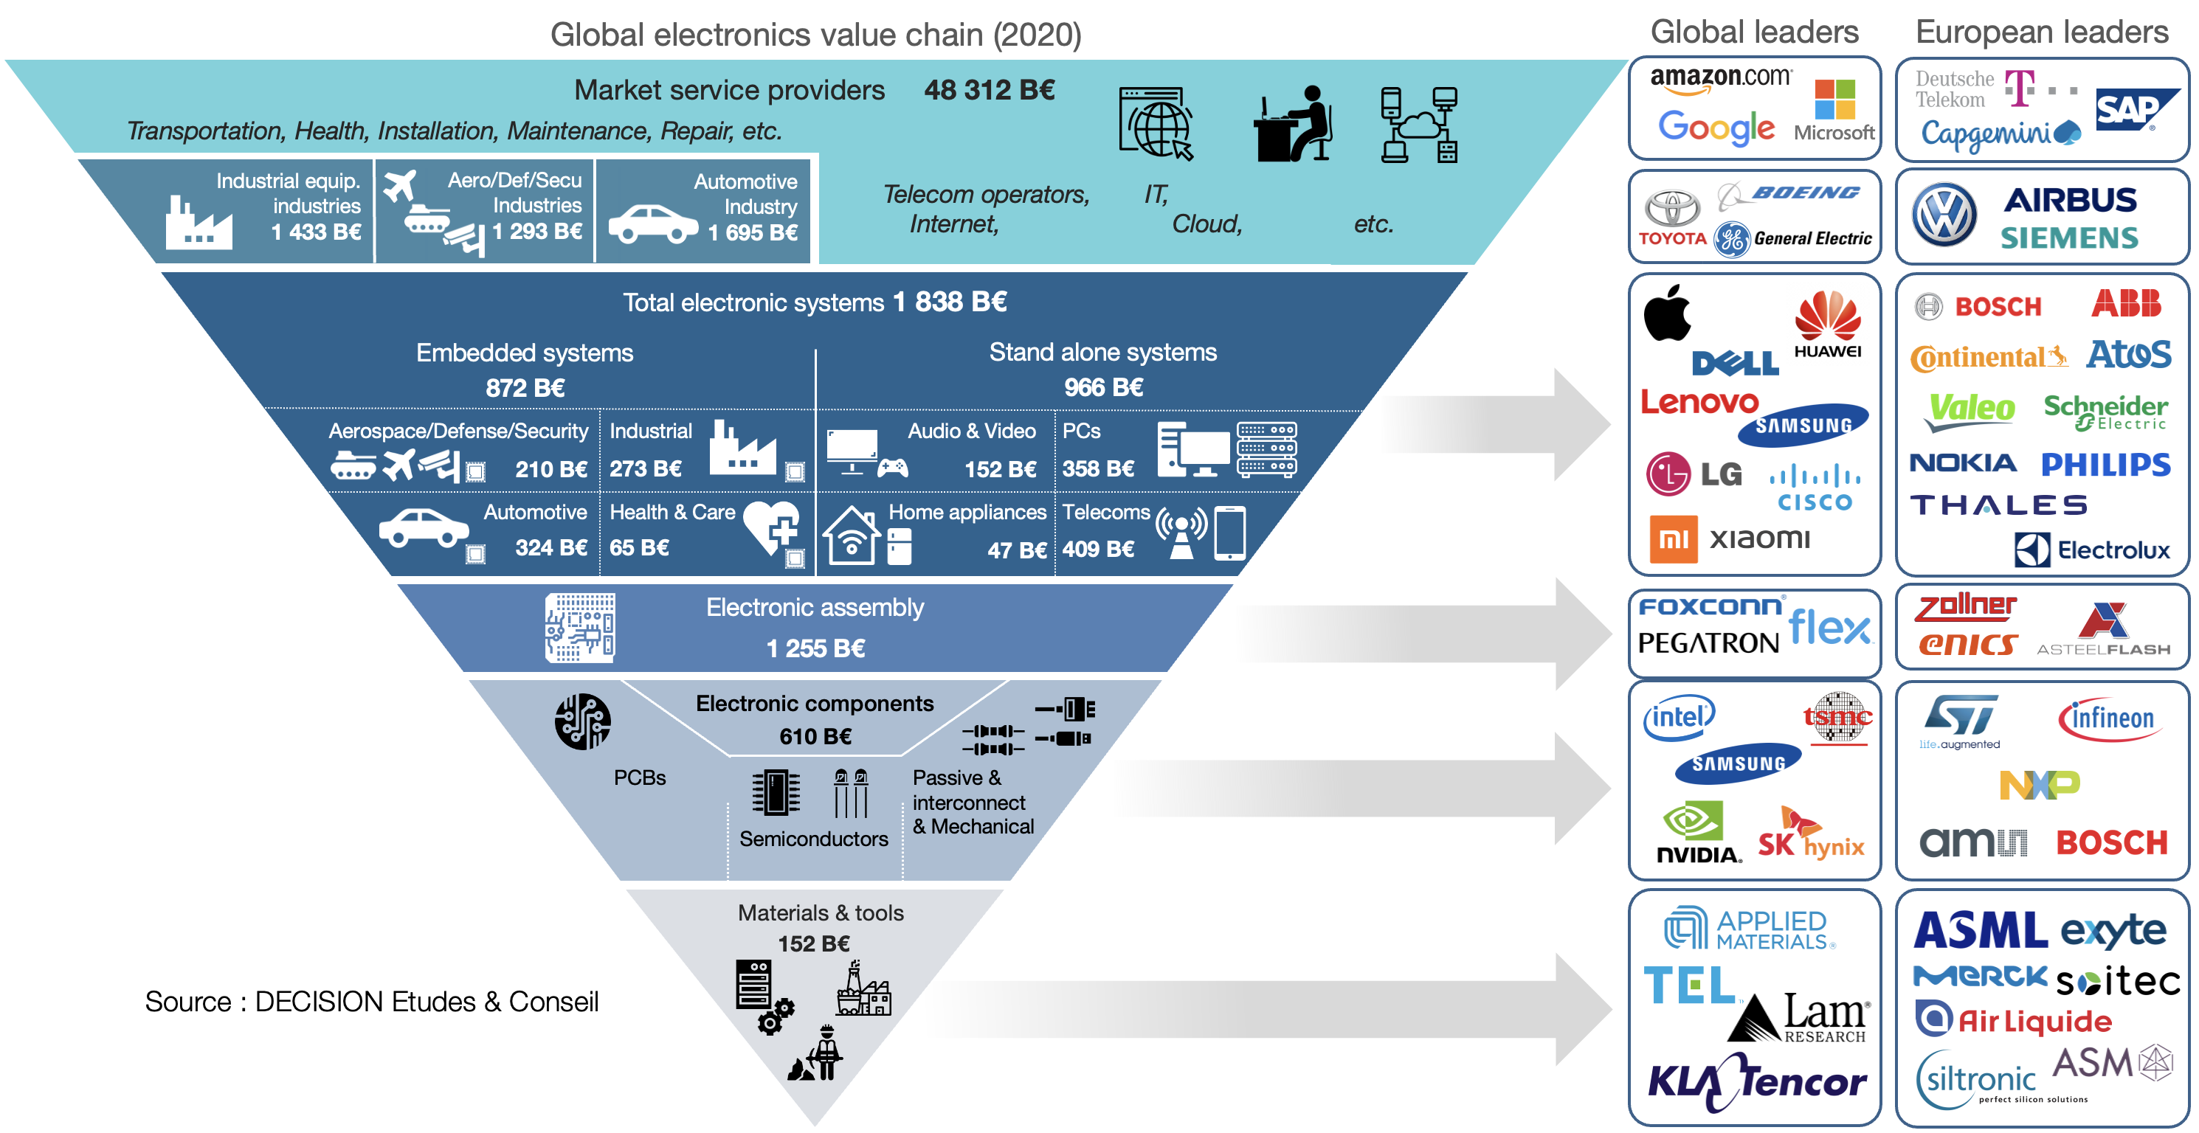
Link to our website
DECISION Etudes & Conseil
Market research consulting – Specialist of the European electronics value chain

Slide 3
Agenda
Skills monitoring within METIS
Industry needs – Microelectronics job profiles & skills
Job profiles
Technical skills
Soft skills
Key evolutions since 2020
New profiles integrated in ESCO
Next steps

Slide 4
Agenda
Skills monitoring within METIS - Achievements
Industry needs – Microelectronics job profiles & skills
Job profiles
Technical skills
Soft skills
Key evolutions since 2020
New profiles integrated in ESCO
Next steps

Slide 5
10 Workshops
316 stakeholders surveyed
Market Research from DECISION
80 Structured Interviews
Our approach
Our reports on semiconductor skills needs in the EU
Report “Skills and Occupational Profiles for Microelectronics” 2021
METIS Skills Strategy 2021
Yearly Monitoring Report 2022
Yearly Monitoring Report 2023
Link to the reports

Slide 6
“Skills and Occupational Profiles for Microelectronics”
Anticipate skills and occupational profiles in the EU
Mismatches between offer and demand on the European microelectronics job market
Most critical skills
Most critical job profiles
Needs in specific sectors: Design, manufacturing process, manufacturing equipment, materials
Impact of emerging technologies
+ 30 job profiles identified and described: Associated main skills, emerging skills, educational levels, duration to fill positions, etc.
Proposition of new occupational profiles for microelectronics
+4 ESCO profiles in microelectronics
+ 25 other profiles that could be added
“METIS Skills Strategy”
Identify trends, challenges and opportunities
Position of Europe in terms of employment
Impact of emerging technologies on the industry
Impact of COVID / shortage/ Chips act / Investments
Diversity in electronics
Skills strategy
Best practice – 10 Initiatives to be benchmarked (HR, policy, etc.)
Policy recommendations
Recommendations for training modules
Link to the reports
Public reports: Consult the reports for the detailed results

Slide 7
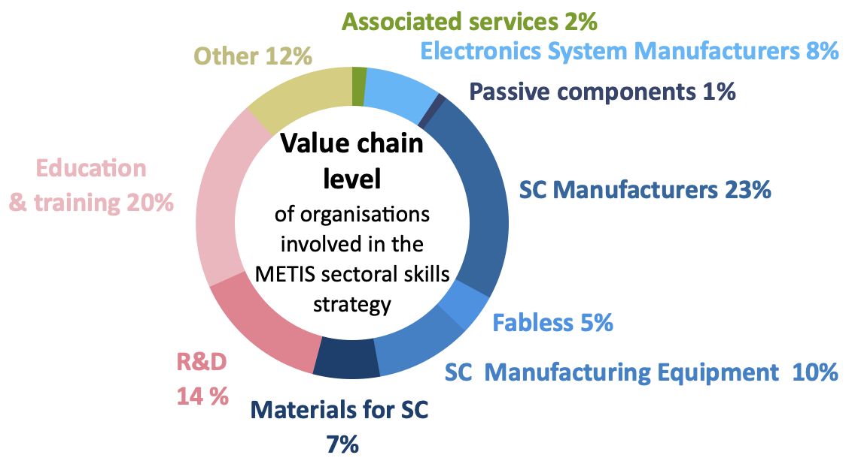
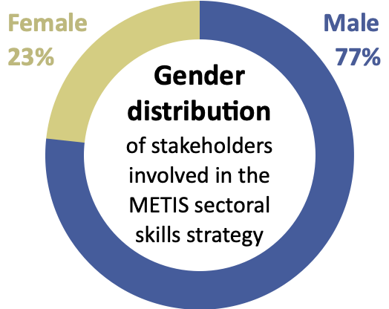
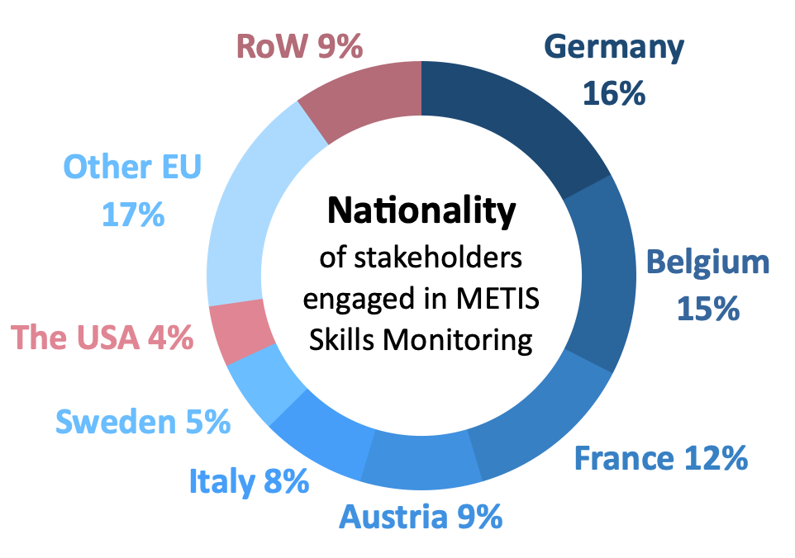
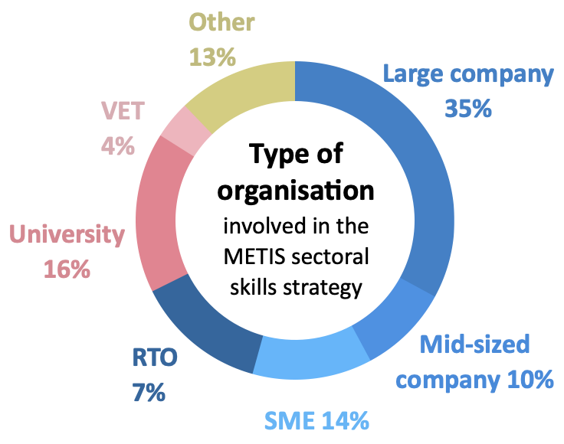
316 stakeholders from 171 organisations engaged
Representative for ~145 000 microelectronics jobs across Europe
~55% of the European microelectronics workforce
23% of respondents were women (More than the average of the sector in Europe)
Organisations having participated the METIS Semiconductor Skills Monitoring
Map - Nationality of stakeholders engaged
Notes:
Large companies

Slide 8
Agenda
Skills monitoring within METIS
Industry needs – Microelectronics job profiles & skills
Job profiles
Technical skills
Soft skills
Key evolutions since 2020
New profiles integrated in ESCO
Next steps

Slide 9
Questions asked
Demand for profiles. Indicate the profiles that are the most sought after by European industry since January 2022 (in terms of number of hires).
Shortage of skilled candidates. Indicate the profiles that are the most difficult to fill for the European industry since January 2022 (greatest difficulty to find skilled candidates).
A critical profile = High demand and great shortage.

Slide 10
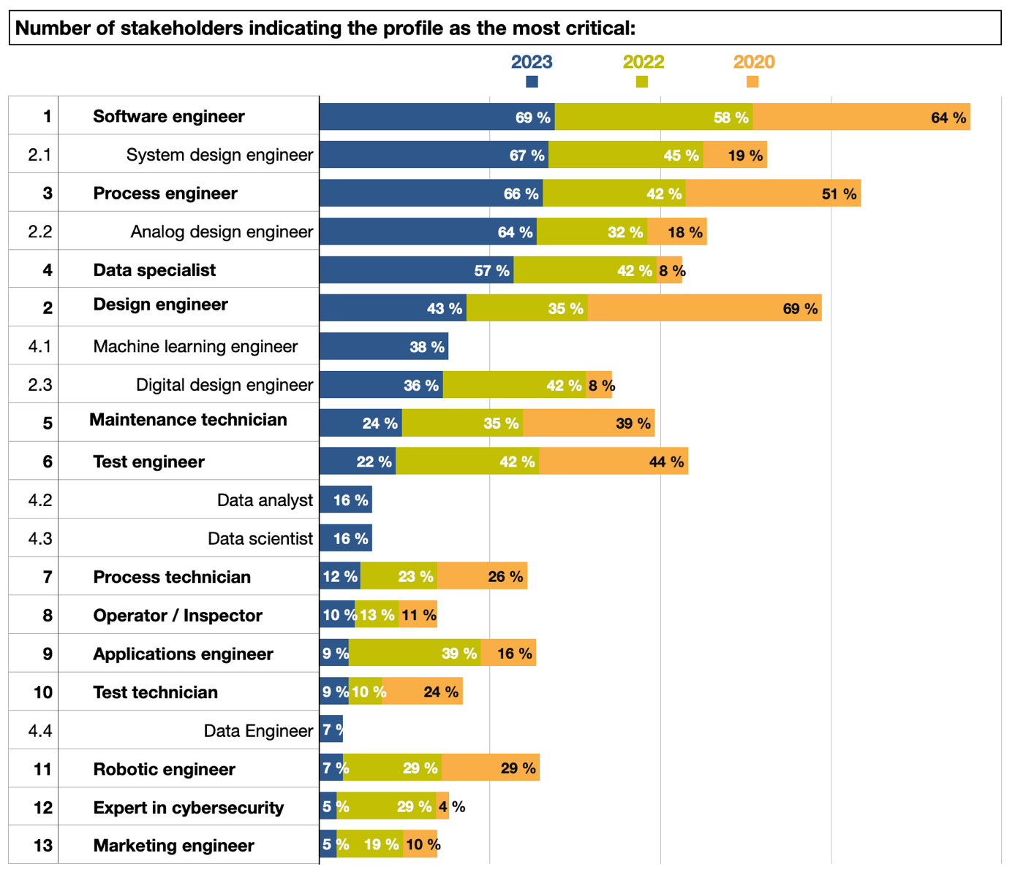
From 2020 to 2023:
Most critical job profiles on the European job market
For this question, all the stakeholders were not limited in their choice of answers and could choose between several job profiles. This is why the totals exceed 100%.

Slide 11
Results & comparison 2023 since 2020
A new profile in the top 5 of the most critical in 2023:
Software engineers: Embedded, Software/Firmware, Machine Learning
Design engineers: Especially system & analog design
Process engineers
Data specialist
Maintenance technicians
The demand and shortage for 4 profiles has significantly raised since 2020:
Data specialist, moving from the 15th position in 2020 to the 4th position in 2023
System designers
Analog designers
Process engineers
The situation seem to have improved since 2020 for junior design engineers, especially digital designers
Machine learning engineers emerges as a new profiles, identified as critical by 38% of the stakeholders interrogated in 2023

Slide 12
Results & comparison 2023 since 2020
The severe shortage of senior profiles on specific topics continues.
Advanced systems architecture designers
Systems test engineers
Senior analog designer, especially associated with strong programming skills
Application engineers. Engineers experts in specific applications fields (automotive…)
Senior managers in general
Another new profile emerges in 2023
Supply chain expert / Logistics specialist

Slide 13
Agenda
Skills monitoring within METIS
Industry needs – Microelectronics job profiles & skills
Job profiles
Technical skills
Soft skills
Key evolutions since 2020
New profiles integrated in ESCO
Next steps

Slide 14
Questions asked
Demand for skills. Indicate the skills that are the most sought after by European industry since January 2022 (in terms of number of hires).
Shortage of skills. Indicate the skills that are the most difficult to fill for the European industry since January 2022 (greatest difficulty to find skilled candidates).
A critical skill= High demand and great shortage.
What is the minimum educational level for which you require the skill?

Slide 15
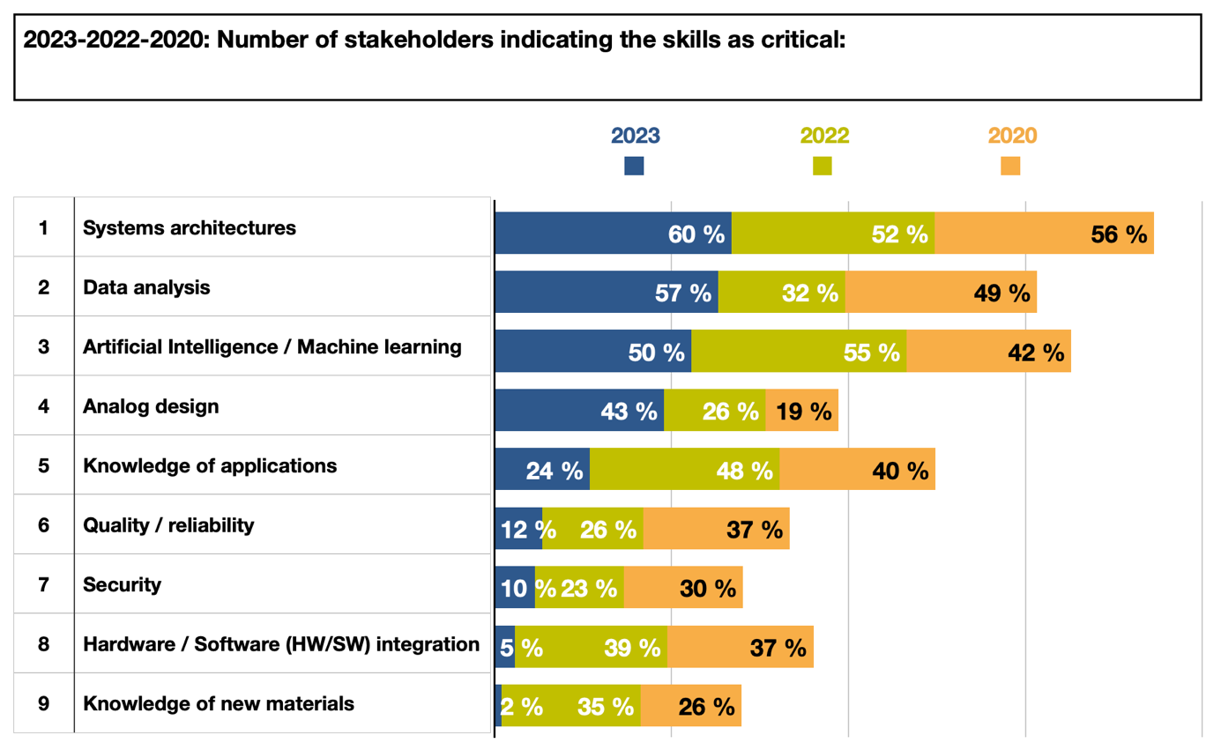
2020 - 2023
Most critical skills/knowledge on the European job market
For this question, all the stakeholders were not limited in their choice of answers and could choose between several job profiles. This is why the totals exceed 100%.

Slide 16
Results & comparison 2020-2023
9 key fields of skills confirmed as the most critical across job profiles
(stable since 2020):
System architectures. Knowledge of systems architectures: SoC, SiP, complex ASICs… Ability to design such architectures.
Data analysis. Increasingly needed by the industry.
Artificial Intelligence / Machine learning.
Analog design.
Knowledge of applications (specificities, linking components, materials, design constraints to apps).
Quality – reliability related skills.
Security related skills.
Hardware / software integration, although less brought to the fore in 2023.
Knowledge of new materials. Especially important for process engineers and material engineers, although this field of skills has been less brought to the fore in 2023 by the stakeholders interrogated.

Slide 17
Key evolutions since 2022
Since early 2022 have you observed new skills emerging in microelectronics? (31 answers)
52% Yes
Verification. Different from the test, verification plays an increasingly important role so that the classical ratio of “one verification person for one designer” in the past is moving to a 2 or even 3 to one ratio. A number of mid-sized companies are growing in design verification. As for design, the shortage of verification skills is especially important for digital mixed signal and analog mixed signal verification.
Design for Manufacturability (DFM). With the increasing complexity of microelectronic designs, considering manufacturing processes and constraints early in the design phase is crucial. Professionals with knowledge of DFM principles, yield optimization techniques, and an experience in working closely with fabrication and manufacturing teams are valuable for roles such as design engineer or process engineer.
Knowledge of the semiconductor value-chain. As the semiconductor industry is increasingly complicated, it becomes increasingly difficult to know how to build the supply chain for a new product and to know how to mitigate risks when new technology is being ramped up.

Slide 18
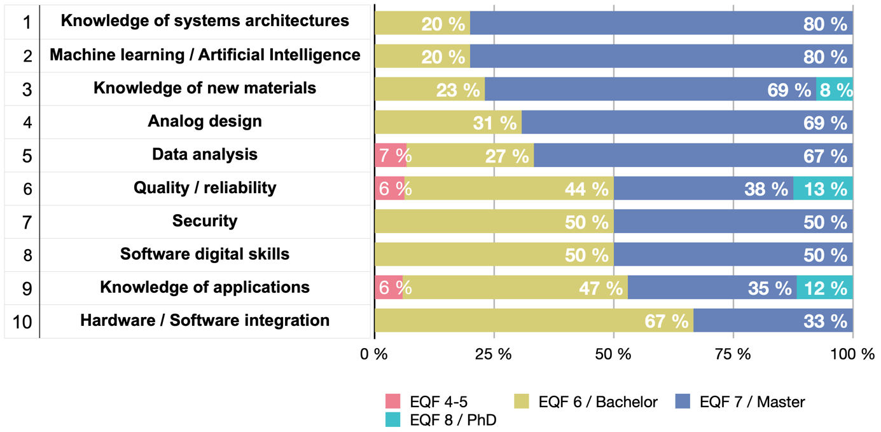
2023: Minimum educational level from which the skill is required
Some strong skills in specific fields can only be found in senior profiles with many years of experience:
Advanced systems architecture design
Strong analog design skills
Expertise in specific applications fields (knowledge of applications)

Slide 19
Agenda
Skills monitoring within METIS
Industry needs – Microelectronics job profiles & skills
Job profiles
Technical skills
Soft skills
Key evolutions since 2020
New profiles integrated in ESCO
Next steps

Slide 20
Most critical soft skills on the European job market
Overall considered as almost important as technical skills.
Most critical soft skills required:
Teamwork & communication: Increasingly complex topics, so teamwork and collaboration between teams become crucial. Ability to summarize complex topics for non-experts.
Creativity: Innovation capacity, ability to propose new ideas, new processes, new designs, to use new technologies, new applications, agile thinking, business thinking for R&D.
Confirmed by the yearly monitoring report 2022 & 2023

Slide 21
Agenda
Skills monitoring within METIS
Industry needs – Microelectronics job profiles & skills
Job profiles
Technical skills
Soft skills
Key evolutions since 2020
New profiles integrated in ESCO
Next steps

Slide 22
Key evolutions since 2020
Exponential rise of investments in manufacturing capacities
Higher recruitment needs => Higher talent/skills shortage, especially seniors
Focus on production capacities: process engineers, maintenance technicians, process technicians…
Semiconductor shortage
Design for resilience / Design for availability / Design for Manufacturability
More skills needed to handle supply-chain management / logistics
Delay in recruitment processes. Leads to delay in business plans progresses and therefore in hires.
Still 67% of stakeholders experiencing no impact of the EU Chips Act on skills needs in 2023
Too early
Strong and raising shortage of skills linked to the topic: Edge IoT / Edge AI

Slide 23
Agenda
Skills monitoring within METIS
Industry needs – Microelectronics job profiles & skills
Job profiles
Technical skills
Soft skills
Key evolutions since 2020
New profiles integrated in ESCO
Next steps

Slide 24
We have integrated 4 new profiles linked to microelectronics in the ESCO platform
Microelectronics designer => Focus on developing and designing systems, from the top packaging level down to the integrated circuit level. System-level understanding with analogue and digital circuit knowledge, integrating the technology processes. Overall outlook in microelectronic sensor basics
Microelectronics smart manufacturing engineer => Microelectronics smart manufacturing engineers design, plan and supervise the manufacturing and assembly of electronic devices and products, such as integrated circuits, automotive electronics or smartphones, in an Industry 4.0 compliant environment.
Microelectronics materials engineer => Design, develop and supervise the production of materials that are required for microelectronics and microelectromechanical systems (MEMS), and can apply them in these devices, appliances and products.
Microelectronics maintenance technician => In charge of preventive and corrective maintenance in semiconductor manufacturing
Up to 25 additional job profiles identified that could be added in the ESCO platform…

Slide 25
Agenda
Skills monitoring within METIS
Industry needs – Microelectronics job profiles & skills
Job profiles
Technical skills
Soft skills
Key evolutions since 2020
New profiles integrated in ESCO
Next steps – Skills Monitoring within the European Chips Skills Academy

Slide 26
DECISION Etudes & Conseil
First figures on the microelectronics workforce in the EU
Value chain | Workforce in the EU27 in 2022 | %
Semiconductors | 161 000 | 53%
Materials & tools | 118 000 | 39%
RTOs | 27 000 | 9%
Microelectronics (total) | 306 000 | 100%
TOP 3 EMPLOYERS in the EU27
24 550 employees
Source: DECISION, Eurostat, company annual reports
19 530 employees
11% growth of employment in the EU27 in 2022
+ 30 000 hires in 2022
19 140 employees
Considering the entire electronics value chain (passive components, electronic boards, systems)
2 720 000 employees are located in the EU
Notes:
2017 : +6%
2018 : +8%
2019 : +7%
2020 : +4%
2021 : +2%
2022 : +11%
6% average growth 2017-2022 (5 years)

Slide 27
The TOP 25 employers in the EU27 in 2023
Materials (7)
Semiconductor (12)
IDM
Design & Conception
Front-end
Back-end
Pure-Play Foundries
OSAT
Equipment (3)
Source: DECISION Etudes & Conseil, 2023
Research & Technology Organizations (3)

Slide 28
This map enables to identify the main European clusters in semiconductor.
Within ECSA, DECISION will assess on a cluster basis the recruitment needs and the training capacities, to quantify gaps.
Source: DECISION Etudes & Conseil, ICOS, 2023

Slide 29
Thank you for your attention!
For more information,
visit http://www.metis4skills.eu
or contact Léo Saint-Martin, Associate Consultant, DECISION Etudes & Conseil (saint-martin@decision.eu.)
Follow METIS4Skills!

